Slide 1
Analyzing Workers’ Voices
WORKERSHIP
Emely
Michael

Slide 2
Table of Contents
Background
Problem
Previous Approaches
Proposed Approach
Limitations
Future Directions
Lessons Learned

Slide 3
What is Workership?
Background
Workership is solving an important need of bringing worker voice to the forefront that is essential for the success of any workplace.
Workership’s data-driven approach can empower a vast number of workers by helping address their needs and also make labor-management relationships much more constructive that it is now.

Slide 4



Motivation
Currently, 60% of US workers feel that they don’t have enough say in their working conditions.
43% of US workers who made a complaint faced retaliation, and worldwide.
25 million people are exploited in forced labor

Slide 5
Understanding the Problem
Problem Definition
Using the Workership Platform has generated a lot of data which is captured in the form of comments from various groups of workers.
The data requires additional analysis to generate meaningful reports that can be useful to management in organizations.

Slide 6
What has been Done Before?
Previous Approaches
Report Generation

Slide 7
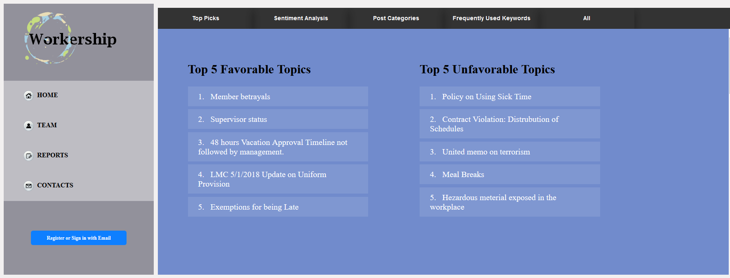
Report | Top Picks
Previous Approaches
This list report consists of the most favorable and unfavorable topics based on the sentiments we analyzed form the comments. It could be helpful the union leaders to determine what they need to shift their focus on.

Slide 8
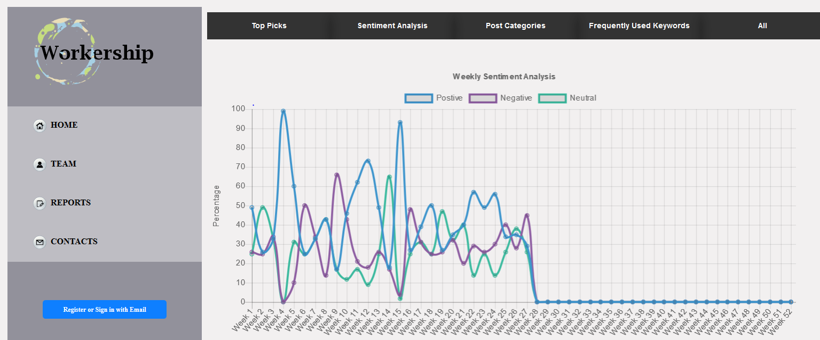
Report | Sentiment Analysis
Previous Approaches

Slide 9
Predicting Worker’s Feelings
Proposed Approach
Extending previous approach in Sentiment Analysis
To analyze comments made on the platform by workers.
To use appropriate algorithms to predict workers’ feelings

Slide 10
Our Steps
Proposed Approach
Data Cleaning
Negation Detection
Predicting Sentiment

Slide 11
Data Cleaning
User generated data from social media type platforms tend to be very “dirty”
There needed to be custom functions specific to our dataset that must be applied to extract the relevant key words
These key words are used by algorithms to assign a sentiment score, and unclean data reduces the accuracy.

Slide 12
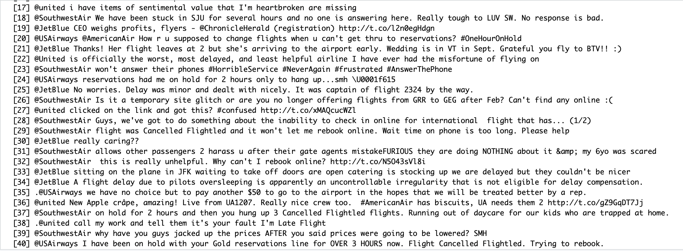
Data Cleaning
Proposed Approach

Slide 13
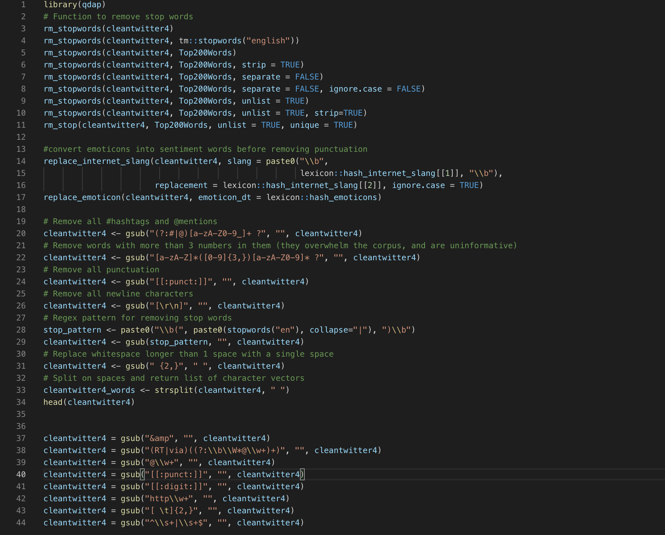

Slide 14
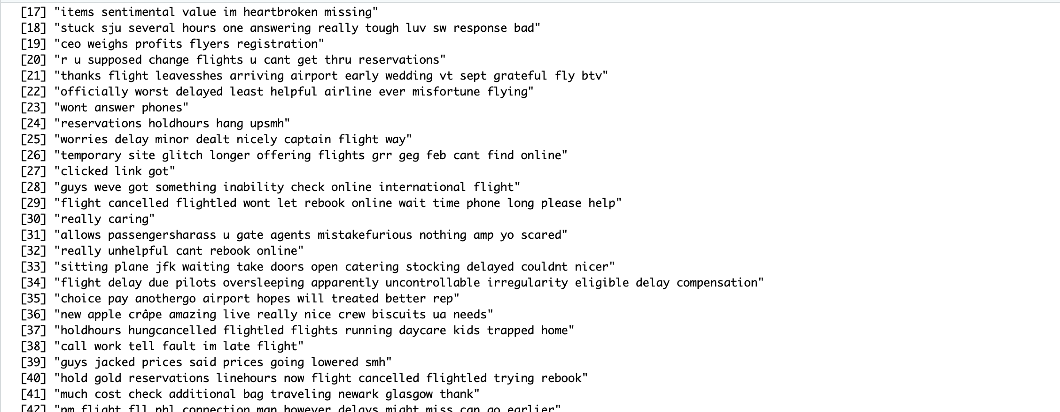

Slide 15
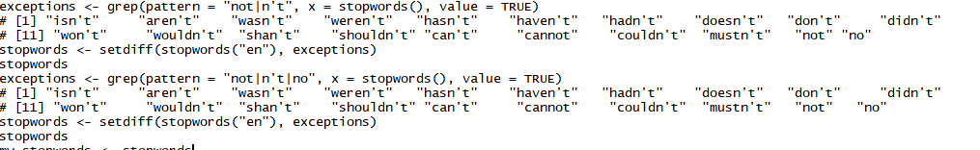
Negation Detection
Proposed Approach
In lexicon approach: Negation Detection was done by adding negation words to our own unique lexicon.
Negation was given its own score of -5. These words included words such as: don’t, no, not, won’t, doesn’t etc.

Slide 16
Sentiment Prediction
Proposed Approach
Lexicon: This approach required the formation of one massive lexicon made up of two other lexicons. One lexicon was our uniquely created negation words lexicon, another was an R package Lexicon, and the final one was a lexicon that we acquired from an author on GitHub.
Machine Learning: We used Logistic Regression, using a corpus made up of clean data and a set of comments we created a document term matrix. From this matrix we acquired features and used the occurrences of those features within a document(or comment) to find a pattern or relationship to the classification of a negative, positive, or neutral comment.

Slide 17
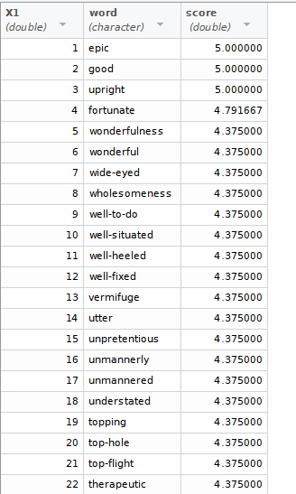
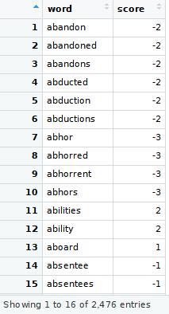
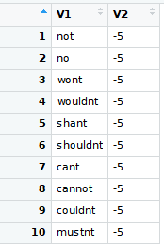
Lexicon

Slide 18
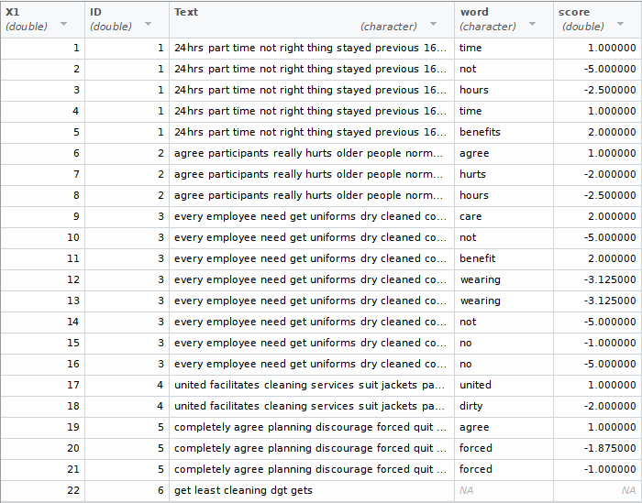

Slide 19
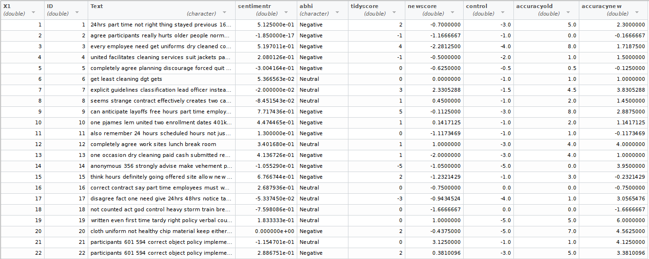

Slide 20

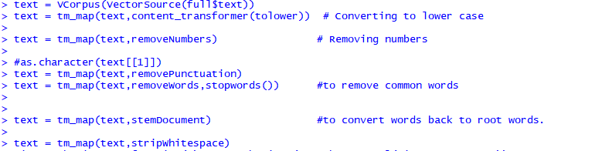
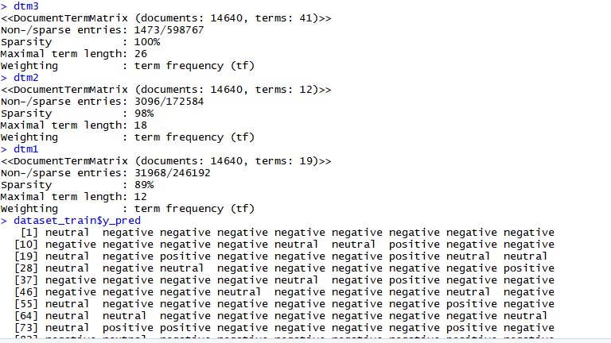

Slide 21
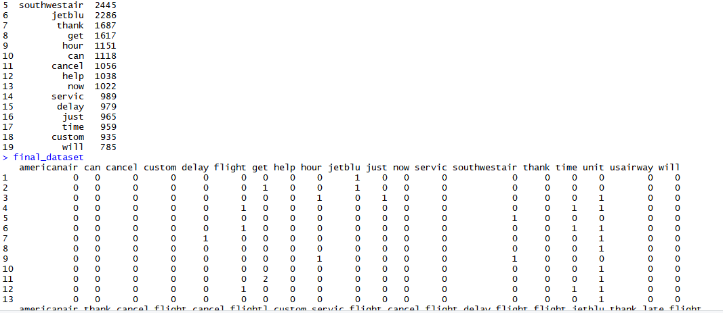

Slide 22
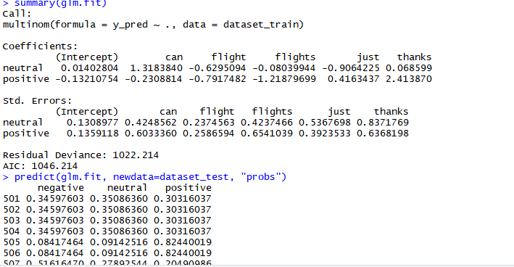
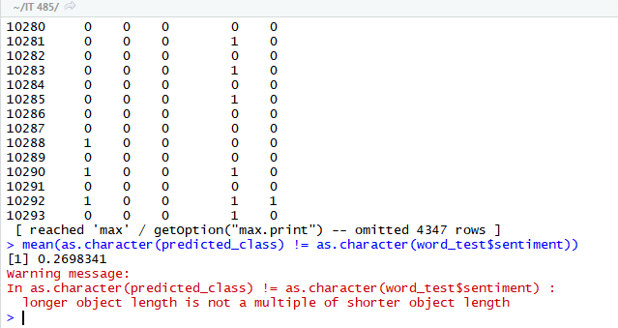

Slide 23
Tools and Techniques Used
Proposed Approach
Machine Learning: Stackoverflow, Data Pre-Processing, R functions/packages (RWeka, nnet, readr, etc).
Techniques included using commands and our tools within R for simple calculations such as mean and range. A large portion of classifications were calculated by appropriate R packages.
Lexicon: R Packages, Data Pre-processing, R functions. TidyText Lexicon, Manual Matrixes for accuracy.
A majority of work within the lexicon was reading and comparing labels manually within excel and using negative-positive-neutral matrix to acquire accuracy.

Slide 24
Limitations
The Lexicon based approach provides a limited capability to properly assign accurate sentiment scores because they don't capture the different forms of text users generate. It is not practical to add so many rules to the lexicon or stop words list to improve accuracy
Words that are usually positive or negative are automatically accounted for in the sentiment algorithm. The use of ngrams does not capture enough context around key words to determine sentiment.

Slide 25
Future Directions
Using a machine learning model that “learns” the pattern of language used in a particular platform to determine sentiment may be more practical and accurate.
Developing a custom made lexicon and stop words list specific to Workership if machine learning approach does not work as planned.

Slide 26
Lessons Learned
This project taught us various amount of techniques to approach difficult tasks such as patience, perseverance, and diligence.
This project required us to learn a new language that was once unfamiliar to us, we learned many preprocessing techniques to clean several thousands inputs of data and erase human error as much as possible.
Classification methods are very important for sentiment analysis because different variations take different attributes into consideration.

